Slide 1
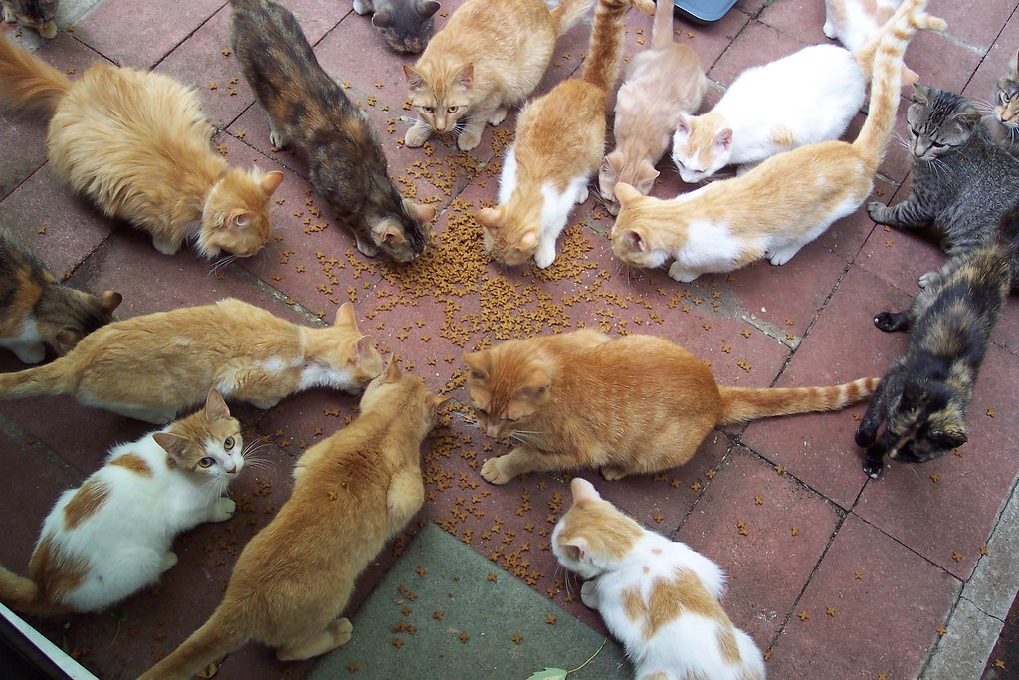
Stray animal management system
Presented by: Anjana Sharma Enrollment No: 15 Guide : Dr. Sartaj Singh Department: MSc Data Science College Name : Lovely Professional University Date:25-11-2025
"The best way to manage stray animals is to treat them with the same respect and care that we would give to our own pets."

Slide 2
Problem Statement and Objectives
Problem Statement Increasing number of stray animals injured, abandoned, or without care
Lack of centralized platform for citizens to report stray animal cases
Delay in rescue response due to poor coordination between public, NGOs & veterinarians
Difficulty in reporting injured or lost animals Lack of centralized data for adoption & rescue
Objectives
To build an online system to easily report allow users to report stray and injured animals instantly
To connect NGOs/volunteers with rescue requests in real time
To manage adoption, reports, contact , animals, and status tracking
Enable public to adopt animals easily

Slide 3
Proposed Solution / Overview
Brief Introduction :
system provides a centralized platform for volunteers, admins, and citizens to manage stray animals efficiently.
It allows reporting, tracking, and adopting stray animals through a user-friendly web interface.
How it Addresses the Problem:
Enables quick reporting of stray animals by volunteers.
Allows admins to monitor, approve, or decline reports and adoption requests.
Reduces response time and improves coordination between public, volunteers, and admins.
Key Innovation or Improvement:
Real-time notification system for adoption requests and volunteer messages.
Easy tracking of animal status (Rescued, Adopted, Under Treatment, etc.).

Slide 4
Components
Main Components:
User Interface Module:-
Allows citizens to report stray animals, submit adoption/volunteer forms, and view updates through a simple and interactive web interface.
Backend Service / API Module (Node.js):-
Processes requests, manages business logic, handles notifications, and connects the frontend with the database.
Database & Data Management Module (MySQL):-
Stores data such as reports, animal records, rescue status, NGO/volunteer details, and adoption/medical history securely.
Technology Stack:
Frontend: HTML, CSS, JavaScript
Provides the user interface for reporting cases, viewing animals, and interacting with the system.
Backend: Node.js ,Handles server-side logic, API creation, routes, and communication between frontend & database.
Database: MySQL
Stores user reports, animal details, volunteer data, adoption requests, etc.
Block Diagram:
User Interface (Frontend) → Backend API (Node.js) → Database (MySQL) → Response back to UI with Status & Notifications

Slide 5
Key Features:
Most Important Features:
Role-Based Access: Volunteers and Admins have different dashboard functionalities.
Animal Management: Add, update, delete, and track animal details.
Reporting System: Volunteers can report stray animals with details like location and condition.
Adoption Requests: Users can submit adoption requests; Admins can approve or decline.
Technical Highlights:
Dynamic tables with JavaScript
Notifications for adoption requests & volunteer messages
Real-time updates with local Storage persistence

Slide 6
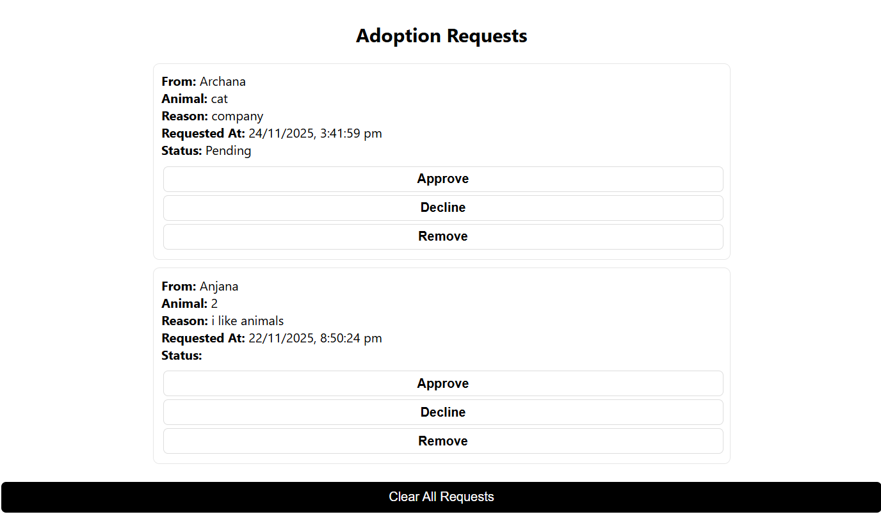
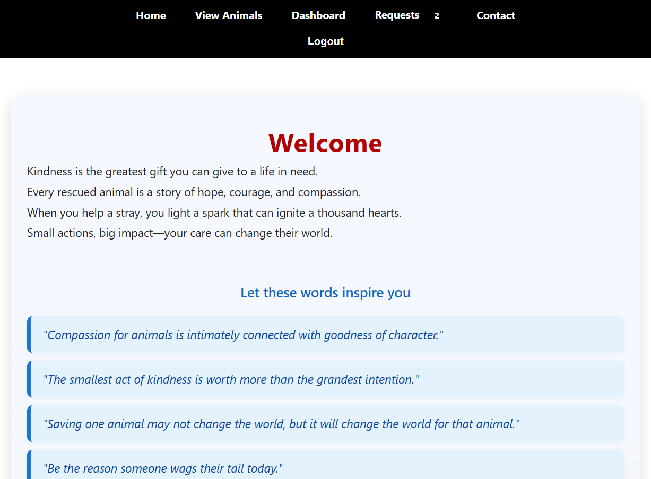
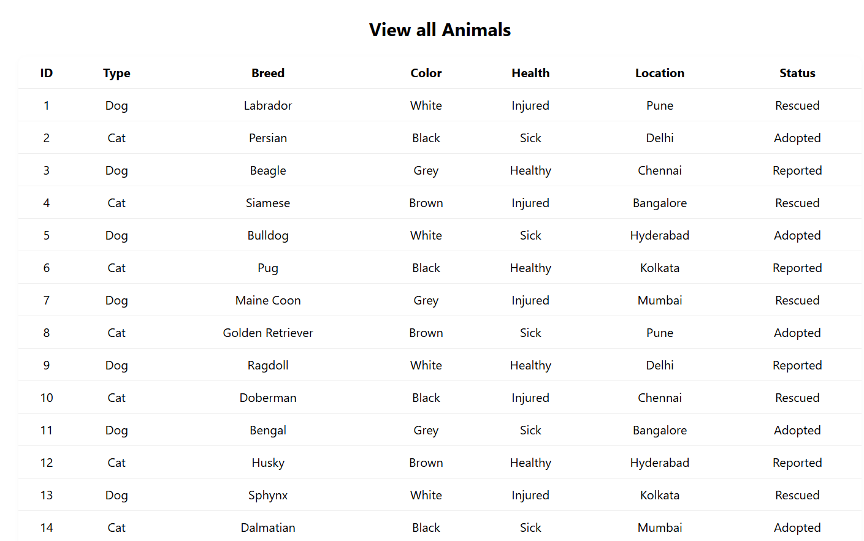
Brief demo screenshots:

Slide 7
Results & Testing
Performance Metrics or Test Results:
Successfully handled multiple users and role-specific dashboards.
Reports and adoption requests were created, approved, and declined without errors.
Animal data correctly updated in real-time in all modules.
Comparison with Existing Solutions:
Unlike basic spreadsheets or manual tracking, system centralizes reporting, tracking, and adoption management.
Offers a role-specific interface and notifications system, which existing solutions often lack.
Success Metrics:
100% accuracy in animal data updates
Successful handling of adoption requests
Volunteers able to report animals and communicate with Admin efficiently
Results:
Quick and centralized reporting of strays.
Adoption requests successfully managed.
Admin can monitor and respond to volunteer messages efficiently.

Slide 8
Challenges & Learning
: DELAY IN HANDLING REAL-TIME RESCUE REQUESTS SOLUTION: IMPLEMENTED NOTIFICATION & STATUS
UPDATE FEATURE TO ENSURE IMMEDIATE COMMUNICATION
BETWEEN PUBLIC, VOLUNTEERS, AND NGOS.
CHALLENGE 2: MANAGING AND STORING LARGE DATA EFFICIENTLY SOLUTION: USED MYSQL WITH OPTIMIZED QUERIES AND
PROPER DATABASE INDEXING TO IMPROVE PERFORMANCE.
CHALLENGE 3: INTEGRATING MULTIPLE MODULES SMOOTHLY
(REPORTING, ADOPTION, VOLUNTEERING) SOLUTION: CREATED MODULAR BACKEND ARCHITECTURE USING
NODE.JS & EXPRESS FOR SEAMLESS INTERACTION BETWEEN COMPONENTS.
Key Learnings
Gained practical understanding of full-stack development including frontend, backend, and database integration.
Learned how to handle real-time data flow and notifications effectively in a practical system.
Improved problem-solving, and ability to convert real-world issues into technical solutions.

Slide 9
Future Scope & Conclusion
Google Maps Integration - Locate animals geographically
Mobile App A simple mobile app can be added to quickly report stray animals and track rescues
Email Notifications - Automated updates to users
Advanced Search - Filter by breed, health, location
Live Chat - Real-time volunteer-admin communication
Analytics Dashboard - Success rates, adoption trends
Two-Factor Authentication - Enhanced security
Conclusion
Built a working Stray Animal Management System with roles for users, volunteers, and admin.
Added important features like reporting animals, adoption requests, and notifications.
Made the process of helping and managing stray animals faster, easier, and more organized

Slide 10
Thank You

